Slide 1
ESP32

Slide 2
Agenda
Overview of ESP32 Hardware
ESP32 Evaluation Board Overview
Wireless connectivity and Additional Features + RS485
Reason for ESP32 and Conclusion

Slide 3
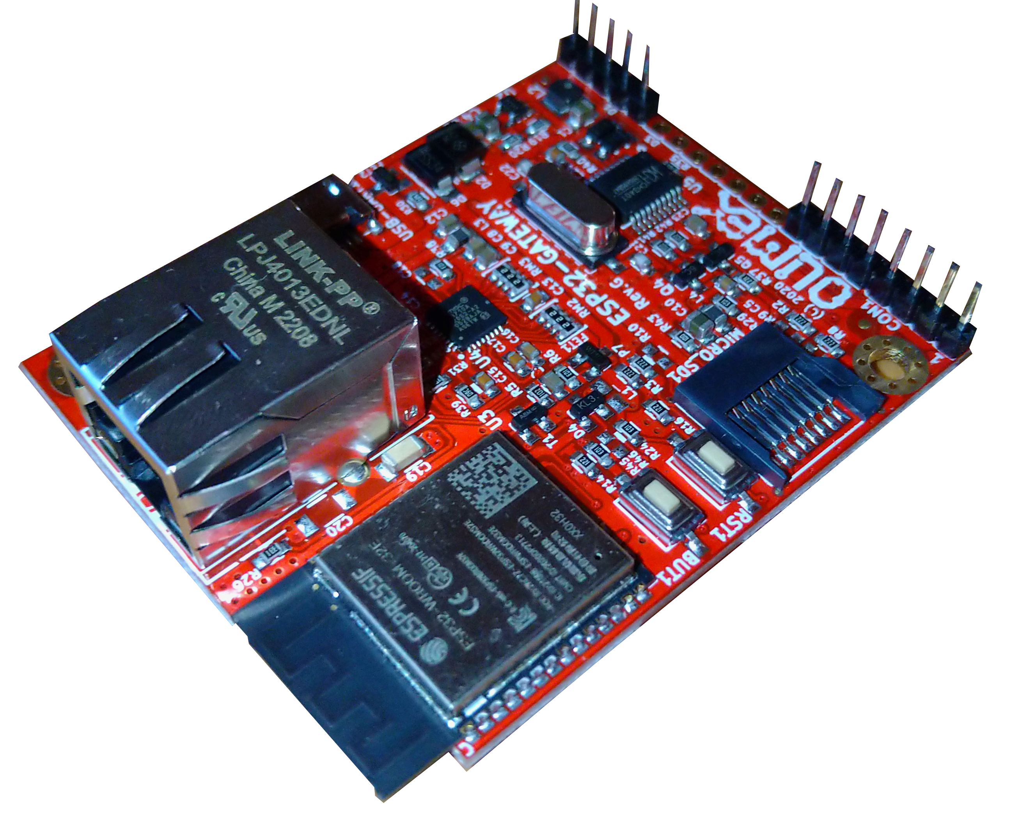
Overview of ESPHome
The ESP32 is a versatile microcontroller developed by Espressif Systems.
Known for its powerful capabilities, including a dual-core Tensilica LX6 microprocessor.
Features :
Dual-Core Processing: ESP32 features a dual-core architecture, allowing for parallel processing and improved performance.
Wireless Connectivity: Built-in Wi-Fi and Bluetooth capabilities enable seamless communication and data exchange.
GPIO Pins: The ESP32 is equipped with a generous number of GPIO pins, providing flexibility for interfacing with various devices and peripherals.
Integrated Peripherals: It includes several integrated peripherals such as SPI, I2C, UART, and more, enhancing its compatibility with a wide range of sensors and actuators.
1. ESP32 Hardware

Slide 4
ESP32 Board
GPIO pins
Power supply
Ethernet Port
SD card slot
Reset button
Boot button
Processor

Slide 5
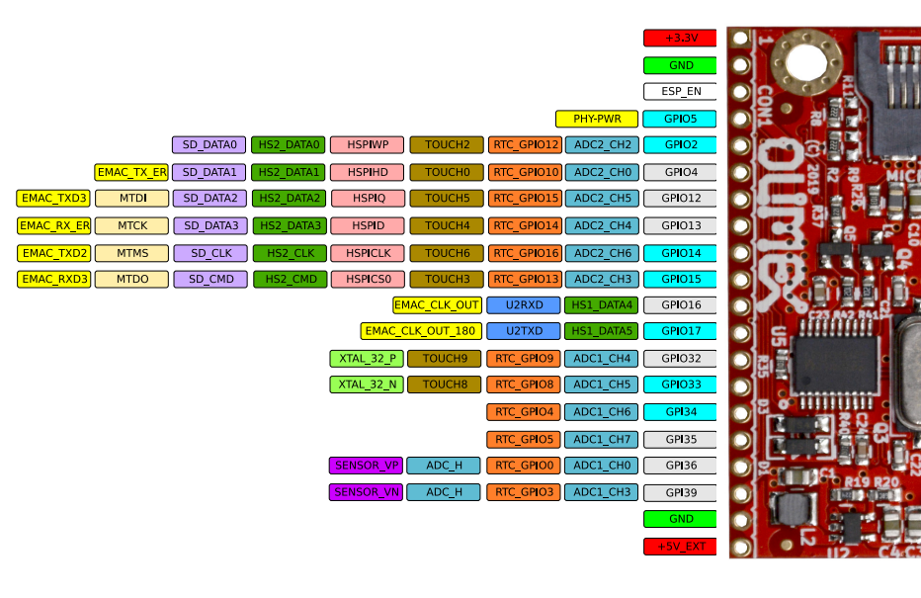
Wireless connectivity and GPIO pins
Clock frequency range (e.g., 80 MHz to 240 MHz).
Memory details: SRAM, Flash memory
Integrated 802.11 b/g/n Wi-Fi transceiver.
Support for WPA/WPA2/WPA3 security protocols.
Integrated Bluetooth v4.2 and BLE capabilities.
Support for I2C, SPI, and UART.
Upto 18, 12-bit ADC
Two 8-bit DCA

Slide 6
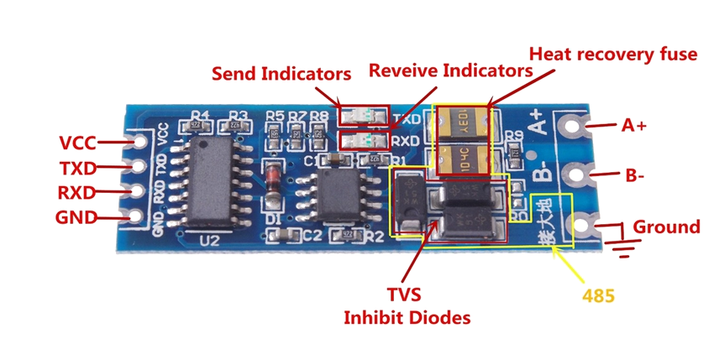
RS485

Slide 7
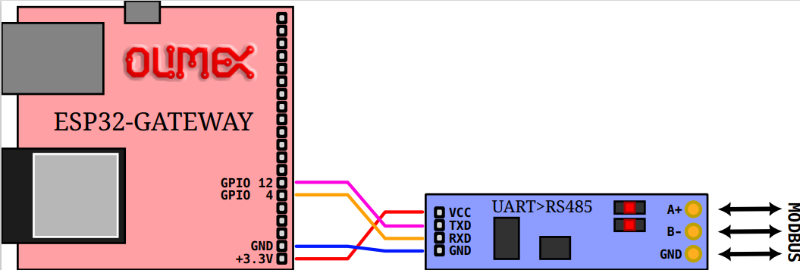

Slide 8
Reasons to Use ESP32
Dual-Core Processor
Wireless Connectivity
Abundance of GPIO Pins
Low Power Modes
Affordability
Arduino Compatibility

